Slide 1

Unveiling the Dynamics of House Valuation in a Dynamic Market: An Exploratory Data Analysis (EDA) for Real Estate Pricing
Welcome everyone! Today, we'll embark on a journey to understand the ever-changing world of real estate pricing through the lens of Exploratory Data Analysis (EDA). We'll delve into a real estate dataset to uncover the key factors influencing house valuations in a dynamic market. This analysis will equip you with valuable insights for making informed decisions in the exciting realm of real estate.
PRESENTED BY:
GEET GOVIND

Slide 2

Introduction to EDA
Before we dive into the specifics of real estate pricing, let's establish a strong foundation. Exploratory Data Analysis, or EDA, is a powerful technique used to cleanse, analyze, and visualize data. It allows us to uncover hidden patterns, understand data distributions, and identify potential relationships between variables. This initial exploration serves as the bedrock for building effective models, including those used for real estate price prediction.
Content:
Unveiling Hidden Patterns: EDA is a crucial first step in data science, helping us discover hidden patterns and trends within datasets.
Data Preparation & Analysis: It involves cleaning, preparing, and analyzing data to gain a deeper understanding of its characteristics.
Foundation for Modeling: This exploration lays the groundwork for building robust models for tasks like price prediction.

Slide 3

Data Acquisition and Cleaning
Content:
Loading the Data: We'll leverage Pandas to import our real estate dataset from a CSV or Excel format.
Data Cleansing: Missing values, duplicates, and inconsistencies will be addressed to ensure data quality.
A Clean Slate: This cleaning process ensures a reliable foundation for our analysis.
The first step in our EDA journey is acquiring the real estate data. We'll use the Pandas library, a workhorse for data manipulation in Python, to load our dataset from its CSV or Excel format. Once loaded, we'll meticulously clean the data. This involves addressing missing values, eliminating duplicate entries, and identifying and correcting any inconsistencies. A clean and reliable dataset is paramount for drawing accurate conclusions from our analysis.

Slide 4
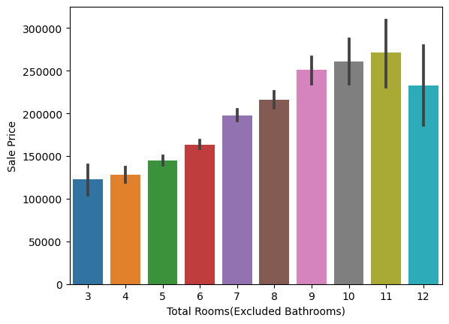
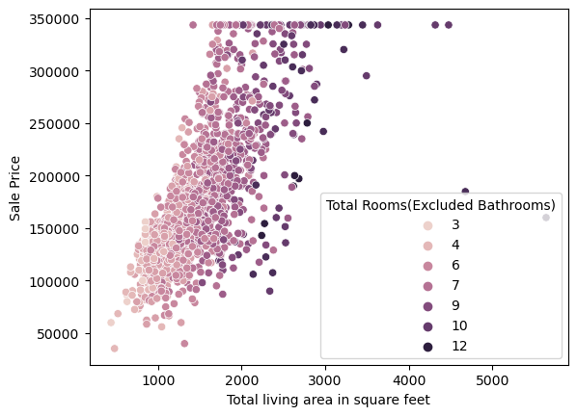
Understanding Individual Variables
Now that we have a clean dataset, let's delve deeper into the individual variables. We'll focus on key features that influence house prices, such as the property's size (square footage) and the number of bedrooms. To understand the distribution of these variables, we'll leverage the power of data visualization. Histograms, kernel density plots, and other compelling visuals will reveal patterns and trends within the data. By analyzing these individual variables, we gain valuable insights into their central tendencies (like average price) and how spread out the data is (how much prices vary).
Content:
Variable Breakdown: We'll focus on key variables like house prices, square footage, and number of bedrooms.
Visualization Powerhouse: Histograms, kernel density plots, and other visualizations will be used to explore their distributions.
Unveiling Characteristics: Analyzing individual variables provides insights into their central tendencies and spread.

Slide 5
Univariate Analysis and Multivariate Analysis
Univariate Analysis
Multivariate Analysis
Univariate analysis involves examining the distribution of a single variable. It helps in understanding the central tendency, dispersion, and shape of the variable's distribution.
Multivariate analysis explores the relationships between multiple variables. It uncovers patterns, correlations, and interactions among various factors affecting house pricing.

Slide 6

Feature Engineering and Size Impact
1. Feature Engineering
It involves creating new features from existing ones to improve model performance.
2. Size Impact
The size of a house significantly affects its market value and pricing.
3. Adapting Features
Understanding how to adapt features to better suit the target market.

Slide 7
Condition and age of the house
1. Original condition
Intact features from the time of construction
2. Renovation History
Past upgrades and improvements
3. Maintenance records
Regular upkeep and care over the years
The condition and age of the house play a crucial role in pricing. Potential buyers are interested in whether the house has retained its original features or undergone renovations. Additionally, they seek details about the maintenance history of the property, which influences its market value.

Slide 8

Market Trends and Demand
Urbanization Technological Advancements
Population migration to Integration of smart home features
urban areas impacting influencing market demand and
demand and pricing values.
trends.
Sustainability
Growing preference for eco-friendly homes affecting market dynamics.

Slide 9
Pricing strategies for sellers
1. Set the right price
2. Showcase the best features
3. Highlight potential for improvement
4. Offer incentives for buyers
5. Work with a knowledgeable agent

Slide 10
Conclusion
By performing a comprehensive EDA, we've gained valuable insights into the dynamics of house valuation. We've explored the impact of individual features, their relationships, and how they influence pricing in a spatial context. This knowledge equips us to make informed decisions in the ever-evolving real estate market.
Thank You!

